Slide 1
Analysis: REDSHIFT

Slide 2
Agenda
Redshift
Redshift Architecture
Redshift in the AWS Ecosystem
Columnar Databases
Redshift Table Design
Redshift Table Design - Distribution Styles
Redshift Table Design - Sort Keys
Redshift Table Design - Data Types
Redshift Table Design - Compression
Redshift Table Design - Constraints
Redshift Workload Management
Redshift Loading Data
Redshift Maintenance and Operations

Slide 3
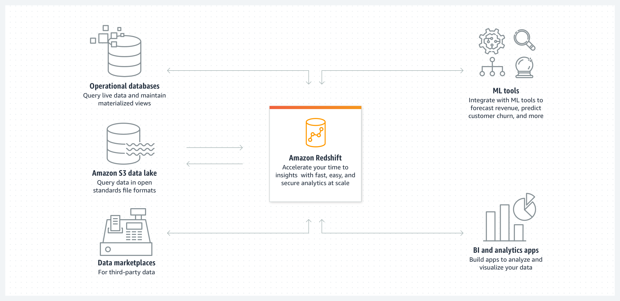
Amazon Redshift
It is a cloud based or data warehouse service that is used for collecting and storing data.
It enables end users to use their data to acquire new insights for their business and customers and simplifies the process of handling large scale data sets.
It costs less to operate & is the fastest data warehouse.
How it works?
It applies SQL to analyze the semi-structured and structured data across operational databases, data warehouses and data lakes.
It delivers the best performance at any scale by using AWS designed hardware and machine learning
Credit: https://aws.amazon.com/redshift/
Notes:
Reference for contents : https://docs.aws.amazon.com/redshift/latest/mgmt/welcome.html

Slide 4
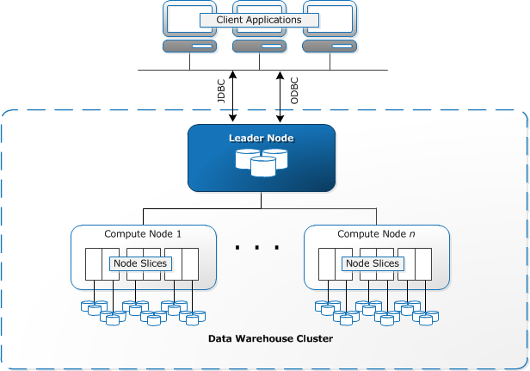
Redshift Architecture
Client Applications: Redshift integrates with multiple ETL and BI tools, it is based on PostgreSQL which leads to minimal changes for existing SQL client applications.
Clusters: The main component of the Amazon Redshift is a cluster. It consists of one or two compute nodes.
Learner Node: It manages communication between client programs and with compute nodes.
Credit: https://docs.aws.amazon.com/redshift/latest/dg/c_high_level_system_architecture.html
Notes:
Reference for contents : https://docs.aws.amazon.com/redshift/latest/dg/c_high_level_system_architecture.html

Slide 5
Compute Nodes: Leaders nodes plans the execution and distributes the compiled code to all the compute nodes. These nodes executes the compiled code and sends the results back to the leader node. Every compute node has its own resources (CPU, memory etc)
Node Slices: Compute node is divided into slices. Each slice is assigned resources where it processes the tasks allocated to the node. The leader node assigns the tasks to these slices and they then work in parallel to complete the tasks.
Internal Network: Redshift makes the most of the strong connections and close proximity to give high speed network for the communication between leader and compute nodes. The network on which compute nodes work on is private and not accessible to client applications directly
Notes:
Reference for contents : https://docs.aws.amazon.com/redshift/latest/dg/c_high_level_system_architecture.html

Slide 6
Redshift in the AWS Ecosystem
Redshift in AWS Ecosystem provides following features for getting best data insights in no time and delivering business outcomes.
Redshift Serverless: It is a serverless alternative that makes it convenient to run analytics in seconds without the overhead of doing an configurations and maintenance. With this, any user can get insights from data by simply loading and executing queries on the data in warehouse
Query Editor: It enables the end users to visualize query results with a single click, design schemas and tables, load data and explore database objects. It provides an imaginative editor for sharing SQL queries, analytics and visualization.
Notes:
Reference for contents : https://aws.amazon.com/redshift/features/

Slide 7
Automated Table Design: This automated table optimization picks up the best sort and key to optimize performance for clusters.
Simple API: Redshift eases the task for accessing the data with all type of applications(traditional, cloud and web). It simplifies this task by the help of AWS supported SDK (Python, Java, Ruby, Node.js)
Fault Tolerant: Redshift monitors the status of cluster and automatically replicates data from failed devices and replaces nodes accordingly for fault tolerance.
Notes:
Reference for contents : https://aws.amazon.com/redshift/features/

Slide 8
Redshift Table Design
1. Concept of Automatic Table Optimization
Automatic table optimization automatically improves the design of the tables by applying sort and distribution keys without the need of an system administrator. It is easier to get started with the design of tables as this gives quick performance without manually implementing table optimizations.
It continuously observes the queries interacting with the tables to choose sort and distribution keys to optimize performance for the cluster’s task queue by applying the advanced artificial intelligence methods.
Notes:
Reference for contents : https://docs.aws.amazon.com/redshift/latest/dg/t_Creating_tables.html
More Explanation : To use the benefits of this automatic table optimization feature, Redshift administrator creates new table or alters existing tables. If the existing tables use the “AUTO” sort key then the automatic optimization is already enabled. To check the performance, Redshift determines a sort or distribution key when the queries are executed on the tables. It then automatically makes changes to the table without the need of an admin.

Slide 9
2. Enabling Automatic Table Optimization Feature
Tables are by default created without explicitly defining distribution or sort keys to ”AUTO”.
While creating a table, a user can explicitly set a sort or distribution key manually. In this case, the table design will not be automatically managed.
To enable this automatic optimization feature to an existing table, user must use the “ALTER ” option in order to set the table to “AUTO”.
Eg: Alter Table table_name Alter SORTKEY AUTO;
Alter Table table_name Alter DISTSTYLE AUTO;
Initially there is no key assigned to the table. As the table size is increased, Redshift applies the optimized sort and distribution keys.
Notes:
Reference for contents : https://docs.aws.amazon.com/redshift/latest/dg/t_Creating_tables.html
More Explanation : For sort key optimizations, Redshift optimizes the data blocks read from disk while scanning the tables.
For distribution style optimizations, Redshift optimizes the number of bytes transferred in between the cluster nodes.

Slide 10
3. Removing Automatic Table Optimization Feature
Tables can be removed from the automatic table optimization feature. In order to remove this feature, the user needs to select a distribution style or a sort key.
To modify style of distribution, we can follow the below commands:
Alter Table table_name Alter DISTSTYLE ALL.
Alter Table table_name Alter DISTSTYLE EVEN
Alter Table table_name Alter DISTSTYLE KEY DISTKEY c1
To modify sort keys, we can follow the below commands:
Alter Table table_name Alter SORTKEY(c1, c2
Alter Table table_name Alter SORTKEY NONE
Notes:
Reference for contents : https://docs.aws.amazon.com/redshift/latest/dg/t_Creating_tables.html

Slide 11
4. Monitoring actions in Table Optimization
To monitor the actions in automatic table optimization, following commands can be used to describe different actions:
SVV_ALTER_TABLE_RECOMMENDATIONS: It records the current Redshift advisor recommendations for the tables. It displays the recommendation of all the tables which are set with automatic optimization and which aren’t
SVV_TABLE_INFO: It lists all the tables in the system along with columns which shows whether the distribution style and sort key is set to AUTO. Entries are displayed as per the current database session.
SVL_AUTO_WORKER_ACTION: It shows a log of the entire actions performed by the Redshift and the prior state of the table
Notes:
Reference for contents : https://docs.aws.amazon.com/redshift/latest/dg/t_Creating_tables.html

Slide 12
Redshift Table Design – Distribution Styles
Objective of Data Distribution Styles
Whenever the data is loaded into the table, Redshift assigns the rows of tables to each compute node in the cluster as per the table’s distribution style.
When the query is executed, the query optimizer re assigns the rows to the compute nodes as required to perform any aggregations or joins.
The aim in selecting a distribution style is to minimize the effect of the re distribution step by identifying the location of data where it should be before the query is executed.
Notes:
Reference for contents : https://docs.aws.amazon.com/redshift/latest/dg/t_Distributing_data.html

Slide 13
Concepts of Data Distribution
Nodes and Slices: A Redshift cluster consists of set of nodes. Each node in the cluster has its own resources like CPU, RAM, OS.
Data Redistribution: Redistribution involves either assigning specific rows to nodes for broadcasting or joining an entire table to all of the nodes
Goals for Data Distribution: It has two primary goals:
To reduce data movements as and when query is executed.
To divide the workload uniformly between the nodes of a cluster.
Notes:
Reference for contents : https://docs.aws.amazon.com/redshift/latest/dg/t_Distributing_data.html

Slide 14
Distribution Styles
There are four distribution styles available when a table is created. These are ALL, EVEN, KEY AUTO
ALL: For every node in a cluster, copy of the entire table is distributed. This style makes sure that all rows for any join required are available.
Eg: Alter Table table_name Alter DISTSTYLE ALL
EVEN: In this distribution the data in the table is spread evenly between the nodes present in a cluster. This is done in a round robin distribution. With the help of Row IDs, distributions are identified and the same number of rows are given to each node.
Eg: Alter Table table_name Alter DISTSTYLE EVEN
Notes:
Reference for contents : https://docs.aws.amazon.com/redshift/latest/dg/r_CREATE_TABLE_NEW.html
https://docs.aws.amazon.com/redshift/latest/dg/c_choosing_dist_sort.html

Slide 15
KEY: Here the data is distributed according to the values in the DISTKEY column. Rows are joined from both the tables are collocated on the compute nodes when the user sets the joining columns of the joining tables as distribution keys
Eg: Alter Table table_name Alter DISTSTYLE KEY DISTKEY c1
AUTO: With this style, Redshift assigns an optimized distribution style based on the size of table data. For instance, when the table is created, Redshift sets the distribution style as ALL, when the table size increases it changes the size to EVEN and when AUTO is selected, Redshift might change the distribution of the table to follow KEY-based distribution
Eg: Alter Table table_name Alter DISTSTYLE AUTO
Notes:
Reference for contents : https://docs.aws.amazon.com/redshift/latest/dg/r_CREATE_TABLE_NEW.html
https://docs.aws.amazon.com/redshift/latest/dg/c_choosing_dist_sort.html

Slide 16
Redshift Table Design - Sort Keys
Working with Sort keys
It is keyword for specifying the column as sort key
When a table is created, one or more of its columns can be defined as sort keys.
When a table is first time loaded with data, the rows are stored on disk in a sorted manner. Information regarding the sort key column is passed to query executor, the executor utilizes this information to develop plans.
There are two types of sort keys that can be used: Compound sort key and Interleaved sort key.
Notes:
Reference for contents : https://docs.aws.amazon.com/redshift/latest/dg/t_Sorting_data.html
More Explanation : Sorting enables efficient smart of data. Redshift stores columnar data in blocks. The min and max value of each block is stored in meta data. If a query uses range based predicate, the query processor can skip the large amount of values and can utilize the min and max values.
Eg: A table contains five years range of data stored by sorted date and the query mentions a date range of one month. Then 96 percent of disk blocks data can be ignored. In case data is not sorted, then more of the data block needs to be scanned.

Slide 17
Compound sort key
It is the default sort key type.
It consists of all columns mentioned in the sort key definition in the order they are specified.
Useful when a query’s filter contains conditions of joins and filters.
It’s performance goes down when the query depends on secondary sort columns without referring to primary columns.
When functions like PARTITION BY and ORDER BY are used, sort keys speed up the GROUP BY, ORDER BY and JOINS operations.
They also help the performance of compression.
The unsorted region grows as and when rows are added to as sorted table that already contains the data. This in turn impacts the performance.
Notes:
Reference for contents : https://docs.aws.amazon.com/redshift/latest/dg/t_Sorting_data.html

Slide 18
Interleaved sort key
It gives equivalent weight to each column or its subsets.
If different queries use multiple columns for filters then to improve the performance of such queries, interleaved sort key can be used.
Improvements in performance given by interleaved sort key must be evaluated against increased vacuum times and load times.
It works well with large tables.
It gives better performance as compared to compound sort key when sorting is done on a single column having a long common prefix.
It uses internal compression scheme which enables them to better differentiate among column that contains long common prefix.
Notes:
Reference for contents : https://docs.aws.amazon.com/redshift/latest/dg/t_Sorting_data.html
More Explanation : These keys are most efficient with highly selective queries that filter out one or more than one sort key columns in the WHERE clause. For eg: select prod_name from product where prod_name = “Chair”. The benefits with this sort key increases with restricted sorted columns.

Slide 19
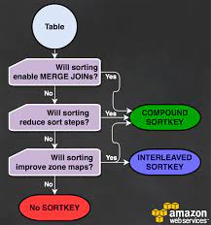
Benefits of using sort keys
Sort keys improves the performance of zone maps which give reduced block I/O operations like read operations.
Sorting removes and reduces the cost of sort steps needed for an SQL operation like PARTITON BY, ORDER BY, GROUP BY.
It facilitates MERGE JOIN operation which is the fastest amongst the three available joins supported by Redshift
Credit: https://aws.amazon.com/blogs/big-data/amazon-redshift-engineerings-advanced-table-design-playbook-compound-and-interleaved-sort-keys/
Notes:
Reference for contents : https://aws.amazon.com/blogs/big-data/amazon-redshift-engineerings-advanced-table-design-playbook-compound-and-interleaved-sort-keys/

Slide 20
Redshift Table Design - Data Types
Amazon Redshift supports following data types:
Multibyte characters
Numeric types
Character types
Datetime types
HLLSKETCH type
VARBYTE type
Boolean type
SUPER type
Notes:
Reference for contents : https://docs.aws.amazon.com/redshift/latest/dg/c_Supported_data_types.html

Slide 21
Multibyte characters: Maximum four bytes of multibyte characters are supported by the VARCHAR datatype. Multibytes characters are not supported for CHAR datatype.
Numeric types: These covers up data types like decimal, integer and floating point numbers.
Character types: These include VARCHAR or CHAR datatypes.
CHAR: Strings that are stored are of fixed length. Eg: char(15)
VARCHAR: Used to store variable lengthed strings. Eg: varchar(150)
Notes:
Reference for contents : https://docs.aws.amazon.com/redshift/latest/dg/c_Supported_data_types.html
https://docs.aws.amazon.com/redshift/latest/dg/c_Supported_data_types.html#c_Supported_data_types-multi-byte-characters
https://docs.aws.amazon.com/redshift/latest/dg/r_Numeric_types201.html
https://docs.aws.amazon.com/redshift/latest/dg/r_Character_types.html
More Explanation : Numeric Type: Integer Types: INTEGER, INT or INT4(4 Bytes), SMALLINT or INT2(2 Bytes), BIGINT or INT8(8 Bytes)
Decimal Types: DECIMAL(precision, scale)
Floating-Point Types: DOUBLE PRECISION, FLOAT/FLOAT8 (8 Bytes), REAL or FLOAT4(4 Bytes)

Slide 22
Datetime types: These datatypes include TIME, DATE, TIMESTAMP, TIMETZ and TIMESTAMPTZ
HLLSKETCH type: Used for Hyper Log Log sketches. Sketch representations which are either sparse or dense.
Eg: {“logm”: 20, “sparse”: {“indices”: [3456, 8567,1967], “values”: [1,2,1]}}
Redshift by default transitions a sparse HLL sketch while exporting, importing or displaying sketches in the above JSON format.
Notes:
Reference for contents : https://docs.aws.amazon.com/redshift/latest/dg/r_Datetime_types.html
https://docs.aws.amazon.com/redshift/latest/dg/r_HLLSKTECH_type.html
More Explanation : Datetime Types: TIME (8 Bytes): It is an alias of time without using Time zones.
DATE (4 Bytes): To store calendar dates only.
TIMESTAMP (8 Bytes) : Alias of timestamp without using time zone. Used to store timestamp values.
TIMETZ (8 Bytes): Alias of time along with time zone.
TIMESTAMPTZ (8 Bytes): Alias of timestamp along with time zone

Slide 23
Boolean type: It is used to store TRUE or FALSE values. Column assigned for this data type stores and prints “f” for False and “t” for True. It is a single-byte column.
SUPER type (stores 1MB of Data): It is used to store documents as values and semi-structured data. Semi-structured data is stored in the form of tags that points to unique entities inside the data.
VARBYTE type (varbyte [(n)]): It stores variable length binary values in a fixed limit. Range of size is 1-1,024,000. It is used in scenarios like joining tables on columns like VARBYTE. Making views that consists of VARBYTE columns. Aggregate functions except COUNT, MAX, MIN GROUP BY on VARBYTE columns are not supported.
Notes:
Reference for contents : https://docs.aws.amazon.com/redshift/latest/dg/r_Boolean_type.html
https://docs.aws.amazon.com/redshift/latest/dg/r_SUPER_type.html
https://docs.aws.amazon.com/redshift/latest/dg/r_VARBYTE_type.html
More Explanation : Super Type : It consists of values like nested structures, arrays and other complex types. It consists of properties like null, number, Boolean, string, arrays, structures(tuples/objects).

Slide 24
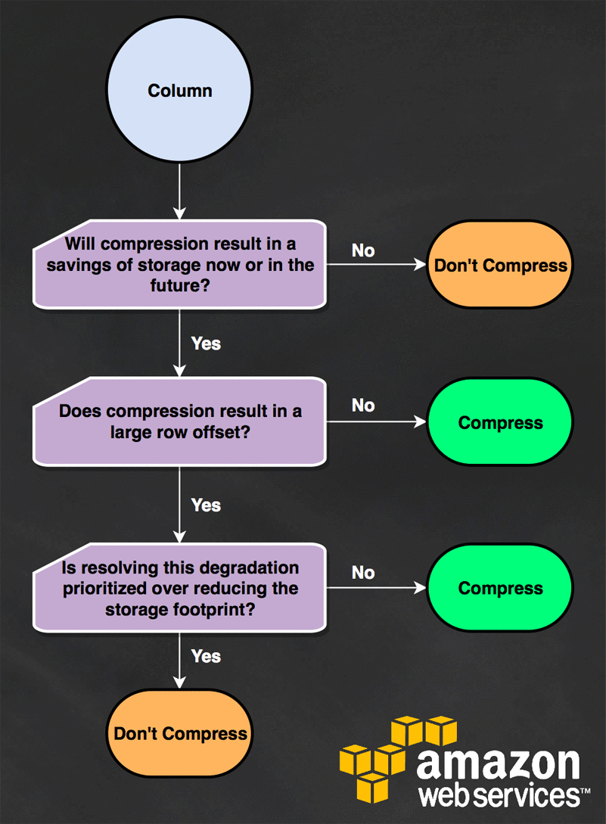
Redshift Table Design - Compression
Compression is a columnar level operation.
It reduces the data size when it is stored.
It saves storage space and minimizes the quantity of data read from storage which leads to improvement in performance as it reduces disk I/O tasks.
Redshift has a feature of automatically managing the encoding of compression for all columns in the table. To enable this feature, use: ENCODE AUTO
Credit: https://aws.amazon.com/blogs/big-data/amazon-redshift-engineerings-advanced-table-design-playbook-compression-encodings/
Notes:
Reference for contents : https://docs.aws.amazon.com/redshift/latest/dg/t_Compressing_data_on_disk.html
More Explanation : Users can also set custom compression encoding as per their requirements. This will turn off the automatic column compression encoding feature offered by Redshift.
Scenarios in which the columns must be compressed:
If the compression results in large offsets of rows.
When storage is a priority.

Slide 25
To manually apply compression, following command can be used when creating the tables:
In the above example, two-columned table is created. Here, prod_id column is not compressed whereas the prod_name column is compressed which uses the bytedict encoding (Byte Dictionary)
It is good to choose encoding of compression manually if the newly created table shares the data characteristics same as of the another table or when the user realizes that automatic compression is not the best fit for the scenario.
Notes:
Reference for contents : https://docs.aws.amazon.com/redshift/latest/dg/t_Compressing_data_on_disk.html
More Explanation : Syntax: CREATE TABLE table_name (column_name data_type ENCODE encoding-type)[, ...]
Eg: create table product ( prod_id int encode raw, prod_name char(15) encode bytedict);

Slide 26
Redshift Table Design - Constraints
Defining Table Constraints
Constraints like primary key, foreign key and uniqueness are just for informational purposes. These constraints are not supported by Amazon Redshift
Although these constraints are for informational purposes, the query optimizer utilizes these constraints to build more effective query plans.
However, they can be used if the ETL(Extract, Transfer and Load) process or any other process in the application enforces their integrity.
Eg: Query Planner in Amazon Redshift uses primary key and foreign key constraints for statistical computations. It order large amount of joins and reduce or eliminate redundant joins.
Notes:
Reference for contents : https://docs.aws.amazon.com/redshift/latest/dg/t_Defining_constraints.html

Slide 27
The Query Planner can have these key relationships but it makes an assumption that all the keys in tables of Amazon Redshift are valid.
In case the applications allows to use primary keys and foreign keys then there might be a possibility of returning incorrect results.
Eg: “Select DISTINCT” may return same rows if the primary key is not unique in nature.
These constraints must be only defined when the user knows the validity of their data.
Apart from the above constraints, Amazon Redshift also doesn’t support NOT NULL constraints.
Notes:
Reference for contents : https://docs.aws.amazon.com/redshift/latest/dg/t_Defining_constraints.html
More Explanation : Note: It is not a good practice to define primary key and foreign key constraints in the tables if you have a doubt regarding the validity of the data.

Slide 28
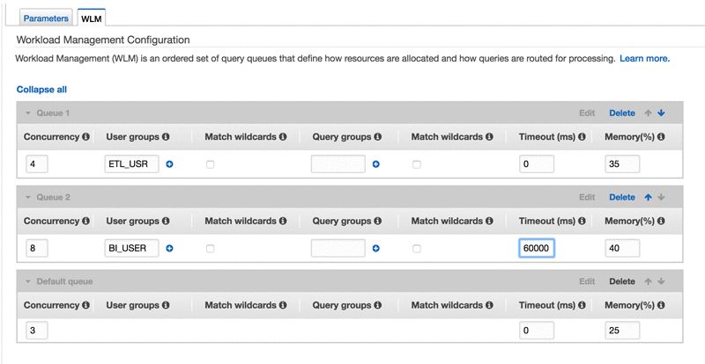
Redshift Workload Management
Amazon Redshift workload management (WLM) feature offers the users to manage their priorities flexibly in the workloads so that small and fast pacing queries don’t get blocked inside the queues of long executing queries.
The screenshot has 3 queues that supports BI, ETL and other kinds of users.
Credit: https://aws.amazon.com/blogs/big-data/run-mixed-workloads-with-amazon-redshift-workload-management//
Notes:
Reference for contents : https://docs.aws.amazon.com/redshift/latest/dg/c_workload_mngmt_classification.html
More Explanation : BI queries are assigned to the short-running queue whereas ETL jobs are assigned to the long-running queue. The default queue executes the queries of other users.

Slide 29
When a query is executed by the user, the first matching queue is assigned with a query by WLM and some set of rules are executed based on the configuration of WLM
Query queues are created by WLM at runtime as per the service classes, which defines the parameters for configuration for different types of queues. This includes user-accessible and system queues.
According to the user perspective, queue or user-accessible service both are equivalent.
Notes:
Reference for contents : https://docs.aws.amazon.com/redshift/latest/dg/c_workload_mngmt_classification.html
More Explanation : Manual WLM
One queue with concurrency level of 5 is configured.
Maximum of five queries can be executed to run parallelly and one pre defined queue of a superuser with a concurrency level of 1.
The user defined queues can have a maximum of total concurrency level of 50. This doesn’t includes Superuser queue.
The simplest way to change the WLM configuration is utilizing AWS Redshift Management Console or AWS CLI or AWS Redshift API

Slide 30
Redshift loading Data
Loading data can take a lot of time specially when the datasets are very large and it will also take up computing resources. The best practices for loading data are:
By COPY command: COPY command can load data parallelly from Amazon EMR, Amazon S3, Amazon Dynamo DB or multiple data sources. It loads large amount of data effectively as compared to INSERT statements. It also stores the data much more efficiently.
Bulk Insertions: Bulk insertion operation combined with “SELECT” clause can raise up the performance of insertion of data.
Notes:
Reference for contents : https://docs.aws.amazon.com/redshift/latest/dg/c_loading-data-best-practices.html
https://docs.aws.amazon.com/redshift/latest/dg/c_best-practices-use-copy.html
https://docs.aws.amazon.com/redshift/latest/dg/c_best-practices-bulk-inserts.html
More Explanation : Bulk Insertion
Eg: INSERT into product_stage (SELECT * from product)
“CREATE TABLE AS” and “INSERT” commands can be used to shift data from one table to another.
Eg: CREATE TABLE product_stage AS SELECT * from product

Slide 31
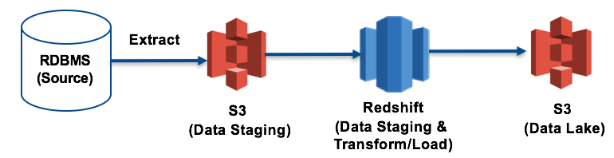
Staging the Tables: New data can be loaded effectively into a staging table first.
In the figure, the data is first extracted from RDBMS to S3 bucket. Then the data is staged to the amazon redshift table for cleansing. After this, data is transformed and loaded into target tables.
Credit: https://aws.amazon.com/blogs/big-data/top-8-best-practices-for-high-performance-etl-processing-using-amazon-redshift/
Notes:
Reference for contents : https://docs.aws.amazon.com/redshift/latest/dg/c_best-practices-upsert.html
More Explanation : Staging Tables: Single merge statements like update or insert also know as upsert are not supported by Amazon Redshift to insert and update data from a data resource. But, a merge operation can be effectively performed. This can be achieved by loading the data into a staging table first and then joining the staging table with the target table for an Insert and Update statements

Slide 32
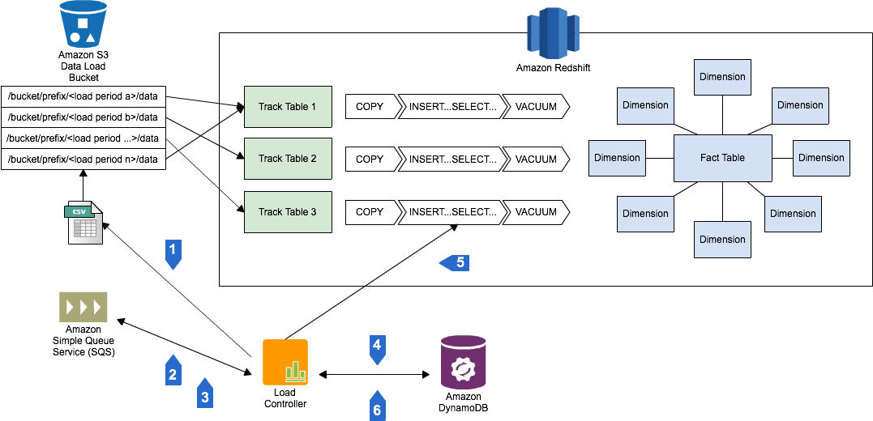
Example of loading data into Amazon S3 bucket using a COPY Command
Credit: https://aws.amazon.com/blogs/big-data/best-practices-for-micro-batch-loading-on-amazon-redshift/
Notes:
Reference for contents : https://docs.aws.amazon.com/redshift/latest/dg/c_loading-data-best-practices.html

Slide 33
Redshift Maintenance and Operations
AWS Redshift Maintenance windows
When a scheduled maintenance is performed at the same time while a query is under execution, then the query is terminated and rolled back. It needs to be restarted again.
Long running operations like VACCUM or loading large data sets needs to be scheduled to avoid maintenance windows.
Data can be loaded in smaller increments to make the restart easy. In this way users can reduce the risk.
Notes:
Reference for contents : https://docs.aws.amazon.com/redshift/latest/dg/c_best-practices-avoid-maintenance.html
https://docs.aws.amazon.com/redshift/latest/dg/c_best-practices-load-data-in-sequential-blocks.html

Slide 34
Following operations can be used:
Loading data into sequential blocks: If a large amount of data needs to be added, then data can be loaded into sequential blocks as per the sorting order which eliminates vacuum. Data loading in smaller blocks leads to less usage of intermediate sorting space during every load
E.g.: If a table needs to be loaded with events from January 2018 to December 2018. If we assume that each month consists of a single file the rows can be loaded for the month of Jan, Feb and so on. When the loading is completed, table will be completely sorted and there’s no need of VACCUM operation
Vacuuming Tables: In vacuum operation, rows are re sorted and spaces are reclaimed in a specified table or in all the tables within the current database session.
Notes:
Reference for contents : https://docs.aws.amazon.com/redshift/latest/dg/t_Reclaiming_storage_space202.html
https://docs.aws.amazon.com/redshift/latest/dg/r_VACUUM_command.html
More Explanation : Amazon Redshift sorts the data by default and executes VACUUM DELETE operation in background. Vacuum operation automatically skips the sort step for any table where more than 95% rows of the table are already sorted. By skipping this step the performance is improved significantly.

